Slide 1
Finding Next Leader
Eager to know who is going to lead us ?!
Cheruvu Lakshmi Manasa - 1210315711
Ramya gana sree Dulla - 1210315706
Mathukumilli Jaya Venkatesh - 1210315761
Lokesh Pepala - 1210315735

Slide 2
Abstract
Sentimental analysis is the concept used for finding next leader. Analyzing the collected twitter data and finding a sentiment to know who is going to be our next leader.
In this project, we extract the information from Tweets in Twitter and perform Sentiment Analysis on Twitter data. We will be getting to know about the Positive and Negative Tweets on Political Leader

Slide 3
Topics
Introduction
Motivation
Literature Survey
Requirements
Methodology
Data Collection
Data Processing
Data Filtering
Data Extraction
Classification
Sentimental Analysis
Results and analysis
Conclusion
References

Slide 4
Introduction
The sentiment analysis extracts positive and negative opinions from the twitter data set.
In this presentation, the sentiment analysis on twitters data using Python programming language in step by step approach.

Slide 5
Motivation:
The work that was used in MuSigma that was used to know which topic were discussed on twitter more and in which way.
This project helps in people to predict the best leader to lead us in future.

Slide 6
Literature Survey 1:
The author Adil Moujahid [1] proposed about data collection using twitter streaming application programming interface. This data can be used in different scenarios such as finding trends related to a specific keyword, measuring brand sentiment, and gathering feedback about new products and services.
In his work, the author compared the popularity of 3 programming languages: Python, JavaScript and Ruby, and to retrieve links to programming

Slide 7
Literature Survey 2:
The author Alexander Galea’s takes the data from several different files (text files of collected data) are executed and the output is obtained as a sentiment.
In his work, author has described the pattern in which all the collected text file data is used for obtaining the result.

Slide 8
Requirements
Hardware requirements:
Software requirements:
Some of the essential hardware requirements for installing Hadoop are:
· Intel Core 2 Duo/Quad/hex/Octa or higher end 64 bit processor PC or Laptop (Minimum operating frequency of 2.5GHz)
· Hard Disk capacity of 1- 4TB.
· 16-512 GB RAM
· 10 Gigabit Ethernet or Bonded Gigabit Ethernet
Some of the essential software requirements for installing Hadoop are:
· VMware Workstation 12 Player
· Ubuntu version-17.04 for hadoop version-2.0
· Python version-3.0.4
· Tweepy
· Pandas
· Numpy
· Textblob
· Matplotlib

Slide 9
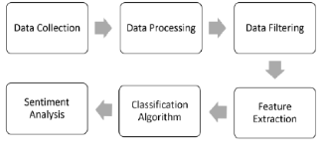
Methodology: The following are the steps
Figure 1: This figure represents the step-by-step process that is followed in my project

Slide 10
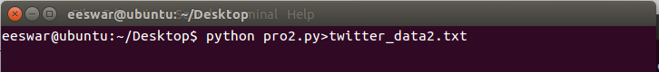
Data collection :
[1]We have to get the following API keys for data collection
consumer_key<-„xxxxxxxx’
consumer_secret<-'xxxxxxxxxxx’
access_token<-'xxxxxxxxxxxx’
access_secret<-„xxxxxxxxxxx’
This is done by creating a developer account in twitter
Figure 2 : This figure represents the command for storing the collected data into a text file directly

Slide 11
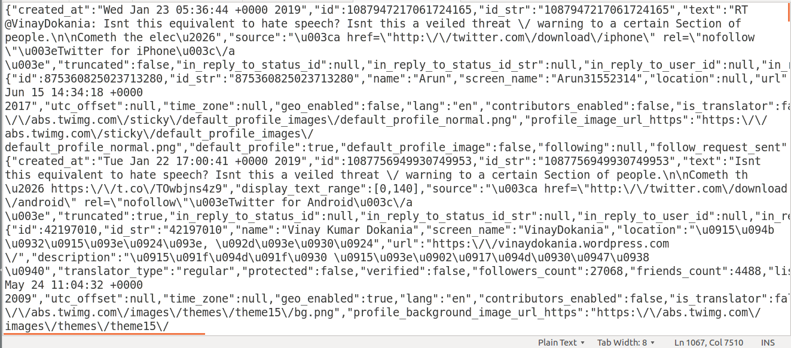
Figure 3 : This figure represents the screenshot of data collection in a text file

Slide 12
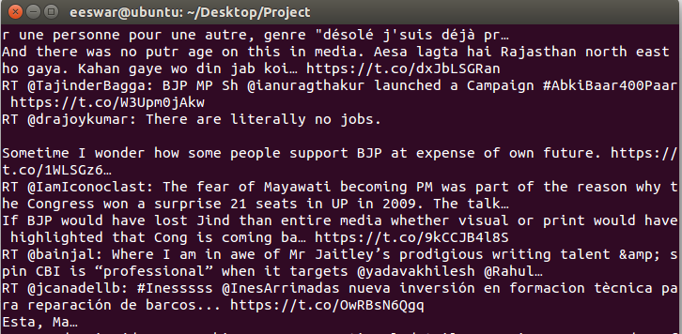
Data Processing , Data Filtering and Extraction:
We process the collected data in the previous step using python code.
The filtering and extraction of data that we need is also done in the same code.
Figure 4 : This figure represents
the filtering of tweets
from the collected data

Slide 13
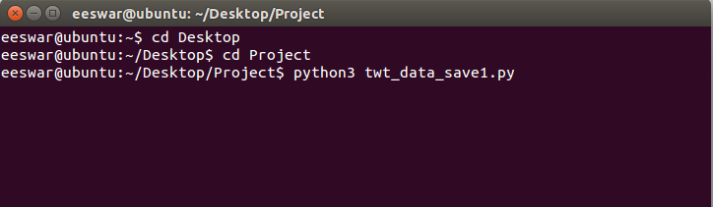
Classification:
The text data that we now have is classified finding polarity of each tweet that has been extracted from the collected data.
Figure 5: This figure represents the commands:
(i) for changing the directory (“cd”)
(ii) for running the python file for classifying the processed data

Slide 14
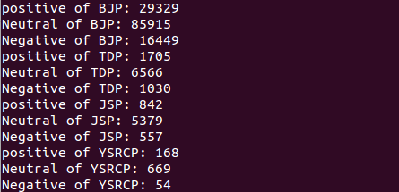
Sentiment Analysis:
The classified data is now analyzed using the Naive’s Bayes algorithm for classifying data into positive, negative and neutral tweets.
Figure 6 : This figure represents the sentiment of the analysis

Slide 15
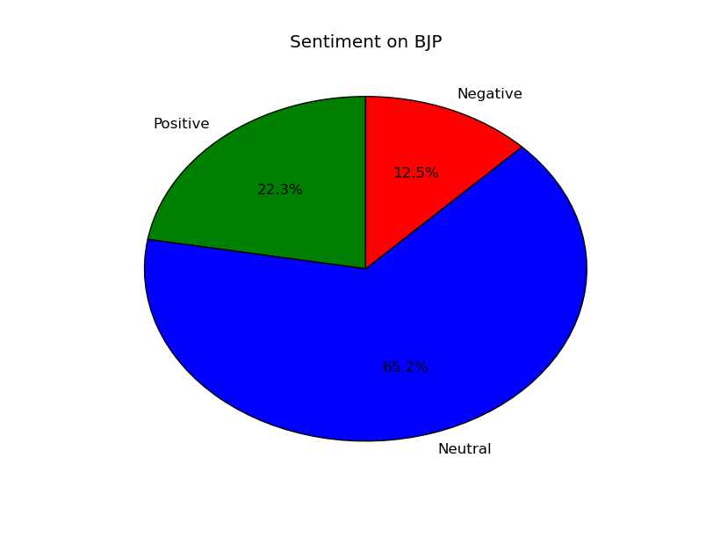
Results and Analysis:
Figure 7 : This pie chart represents the Sentiment on BJP

Slide 16
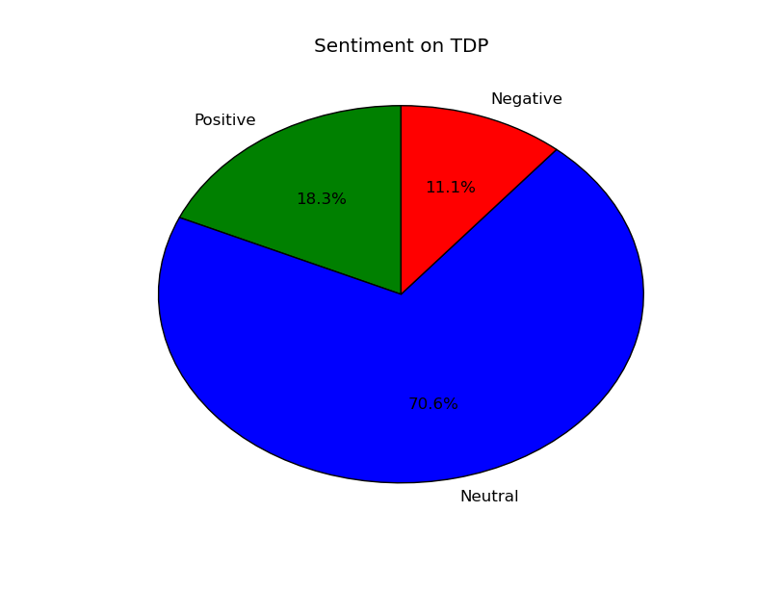
Figure 8 : This pie chart represents the Sentiment on TDP

Slide 17
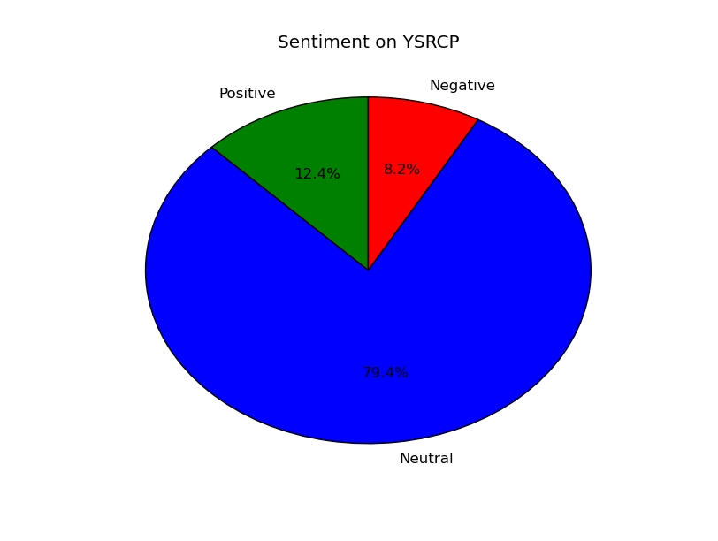
Figure 9 : This pie chart represents the Sentiment on YSRCP

Slide 18
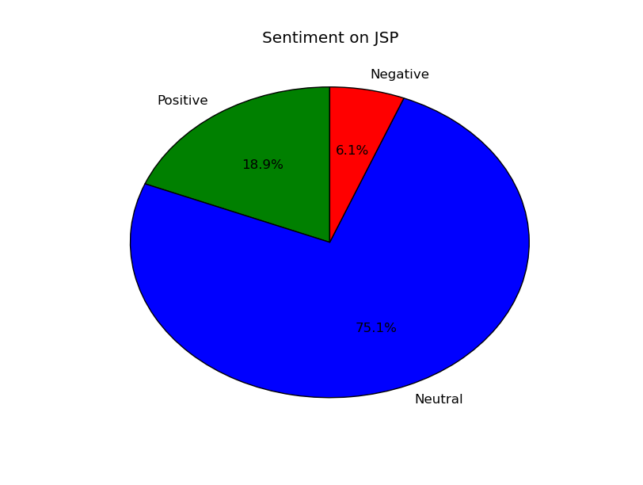
Figure 10 : This pie chart represents the Sentiment on JSP

Slide 19
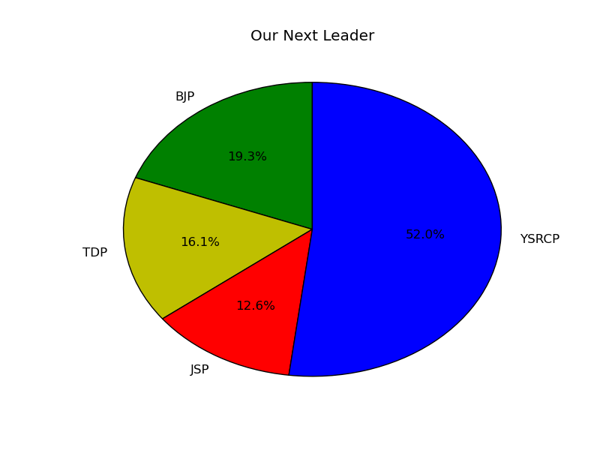
Figure 11 : This pie chart shows the next leader the has been predicted

Slide 20
Conclusion
The sentimental analysis project helps in analyzing the result from a large collection of data using big data.
Sentiment analysis is an efficient method for generating accurate results.

Slide 21
References
[1] Adil Moujahid – An Introduction to text mining using twitter streaming API and Python – Published Mon 21 July 2014
[2] Alexander Galea-COLLECTING TWITTER DATA WITH PYTHON.

Slide 22
THANK YOU

